Slide 1
Week 4
THE relational algebra Binary operation OF INTERSECTIOn

Slide 2
Student Objectives
Upon completion of this video, you should be able to:
Identify the symbol for INTERSECTION
Write a relational algebra expression that uses INTERSECTION given two tables and a query.
Given 2 tables and a INTERSECTION relational algebra expression, show the new table that would be returned once the expression is performed.

Slide 3
INTERSECTION
Creates a new table from the given 2 tables that includes only the identical rows from both tables (no repeats).
The 2 Tables MUST be union compatible
Intersection can be expressed as:
(R U S) - ((R - S) U (S - R))
Symbol → ∩
Example Expression:
Table1 ∩ Table2
Table1
ID | FirstName | LastName | Age
12 | Homer | Smith | 24
24 | Gene | Simpson | 13
45 | Marg | Reid | 45
Table2
ID | FirstName | LastName | Age
33 | Marg | Jones | 28
24 | Gene | Simpson | 13
31 | Milhouse | Lee | 22
Ans ← π _{FirstName} (Table1) ∩ (π _{FirstName} (Table2))
ANSWER
Ans
ID | FirstName | LastName | Age
24 | Gene | Simpson | 13
FirstName
Gene
Marg
First Table Name
Symbol for INTERSECTION
Second Table Name

Slide 4
Example of Intersection:
Table AA:
Table BB:
B
b1
b2
b7
b8
b11
b16
B
b2
b7
b13
QUESTION: What will CC ←AA ∩ BB return?
Table CC:
B
b2
b7

Slide 5
useful in situation with the word both or and, such as list the people who work on BOTH project X and project Y
ProjectX ← π _{ProjectNumber} (σ _{ProjectName = “X”} (Project))
ProjectY ← π _{ProjectNumber} (σ _{ProjectName = “Y”} (Project))
WorksOnX ← π _{SSN} (ProjectX ⋈ Works_On)
WorksOnY ← π _{SSN} (ProjectY ⋈ Works_On)
Answer ← π _{LastName} ((WorksOnX ∩ WorksOnY) ⋈ Employee)

Slide 6
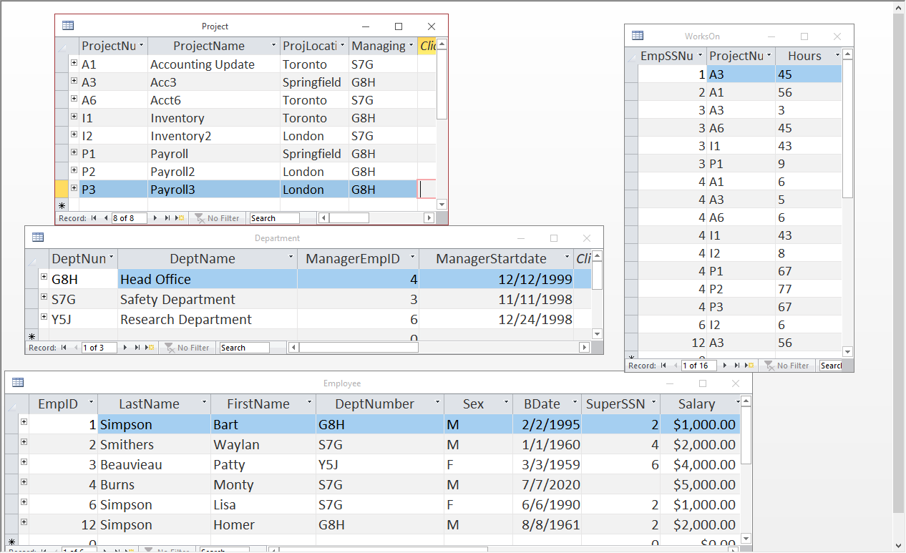
QUESTION: Write the relational algebra to find the project name of all projects that BOTH Simpson AND Smithers work on:
TempSimp ← π_{EmpID} (σ_{LastName= “Simpson”} (Employee))
TempSmit ← π_{EmpID} (σ_{LastName= “Smithers”} (Employee))
WorksOnSimp ←π_{ProjectNumber} (TempSimp ⋈ Works_On)
WorksOnSmit ←π_{ProjectNumber} (TempSmit ⋈ Works_On)
Answer ←π_{ProjectName}((WorksOnSimp∩WorksOnSmit) ⋈ Project)

